Slide 1

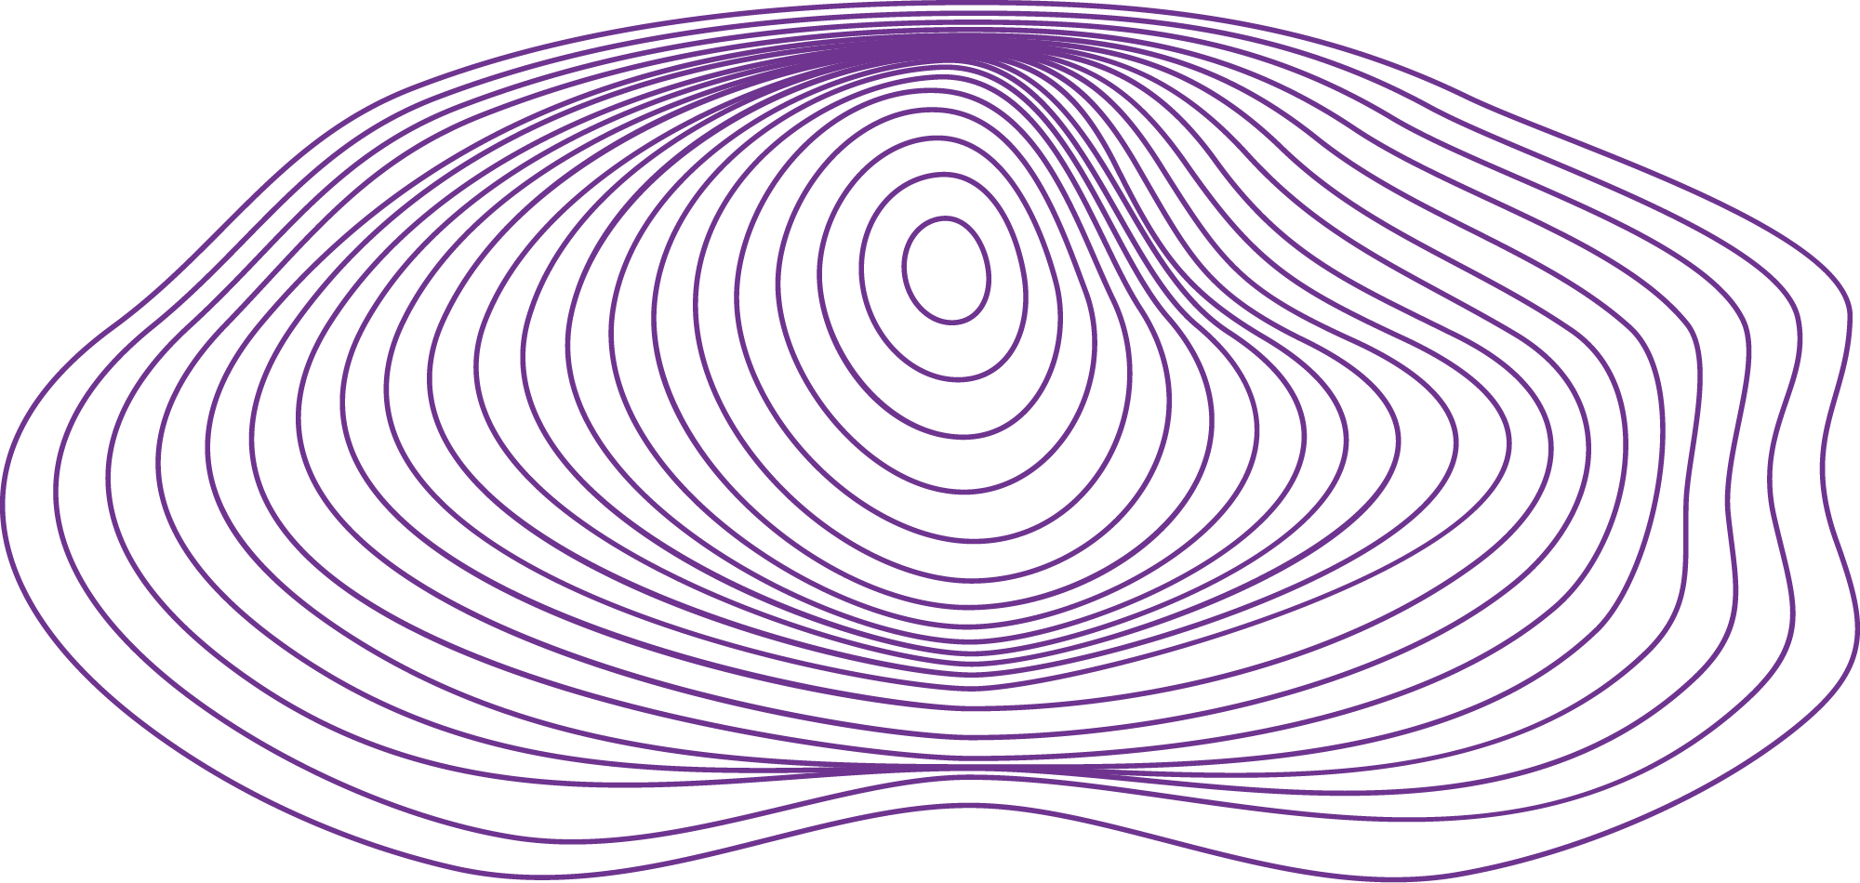
LLMs and Agents
Ethan Jackson, PhD ’19
Co-Founder @ ChainML
Research Scientist @ U of T Social AI
March 14, 2024

Slide 2
Agents in ML and AI

Slide 3
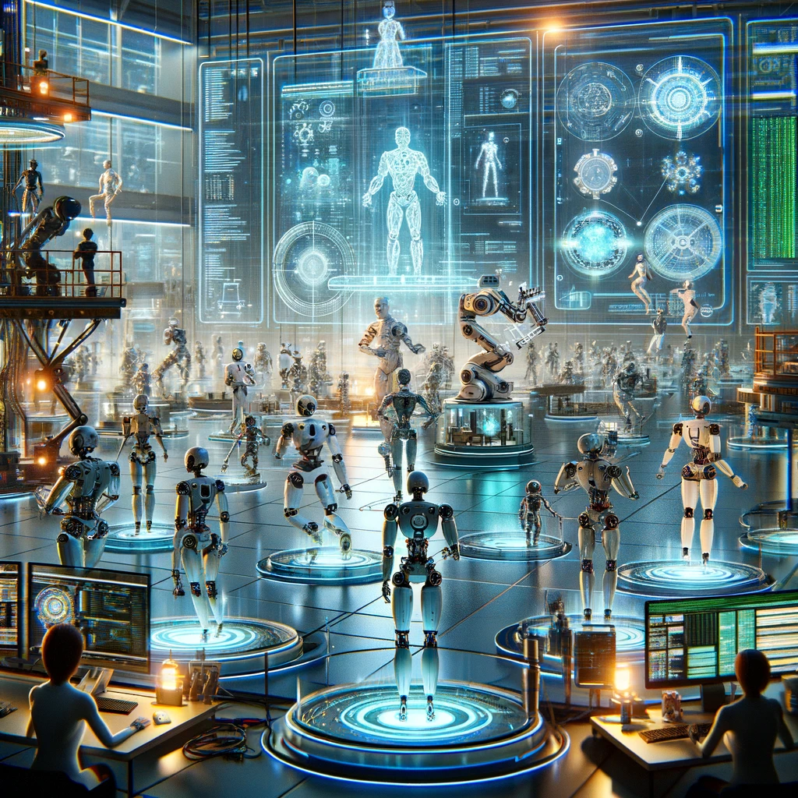
Robotics
Physically Embodied Agents
Physical Sensors and Actuators
Real-Time Requirements

Slide 4

Reinforcement Learning
Goal is often to train agents to act in software environments.
Rich research literature in RL + games.
Through RL is also useful to develop models / algorithms for robots, too.

Slide 5
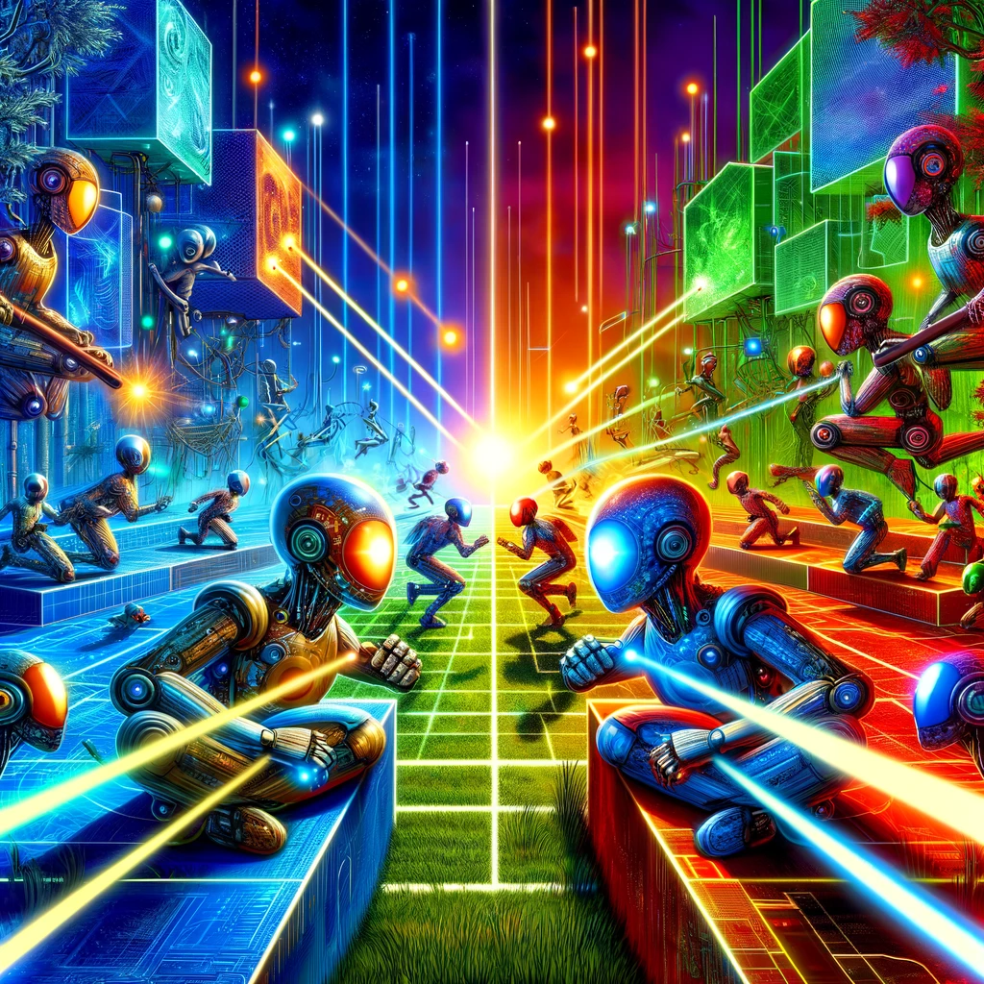
Multiagent Reinforcement Learning
Training multiple agents simultaneously
Cooperative, competitive AI
From individual ‘policies’ to collective, group behaviour.

Slide 6
Large Language Models (LLMs) Transformers

Slide 7

Convolutional Neural Networks
Stacks of ‘filters’ that learn to recognize patterns and features in images at various scales.
Inductive bias for local pattern detection.
Gave rise to massive progress in computer vision.

Slide 8
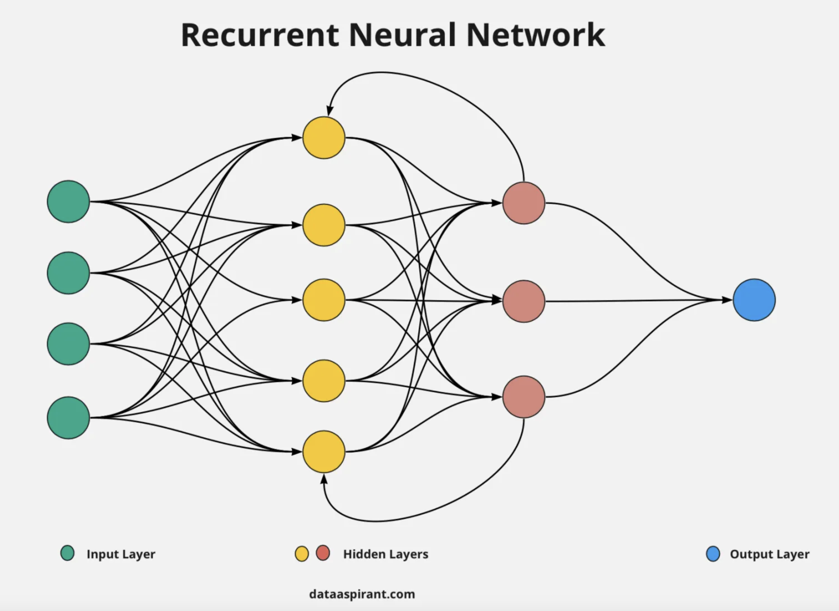
Recurrent Neural Networks
Many problem domains have a natural temporal component.
The human brain is highly recurrent.
Before Transformers, various recurrent neural network models were applied to natural language tasks.
Downsides: RNNs can be difficult and slow to train.

Slide 9

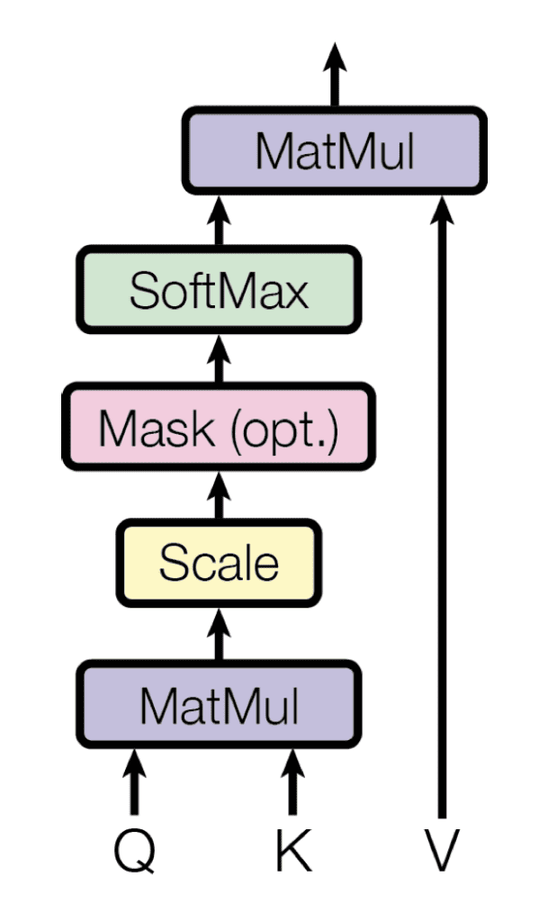
(Self) Attention

Slide 10

Transformer Architecture
Encoder-decoder
Encoder-only
Decoder-only

Slide 11
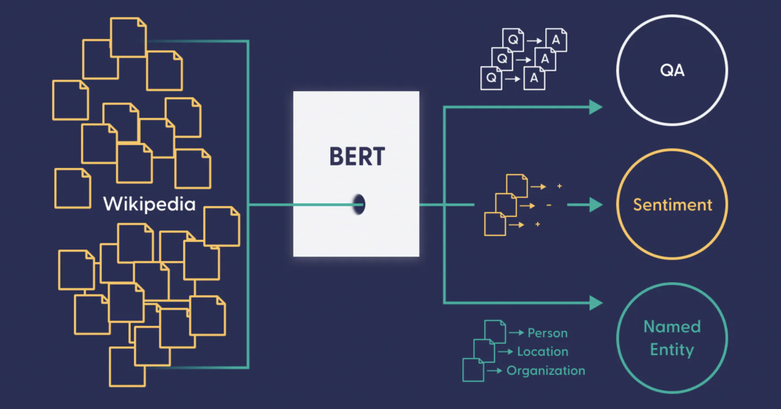
Natural Language Processing Tasks
Notes:
BERT

Slide 12
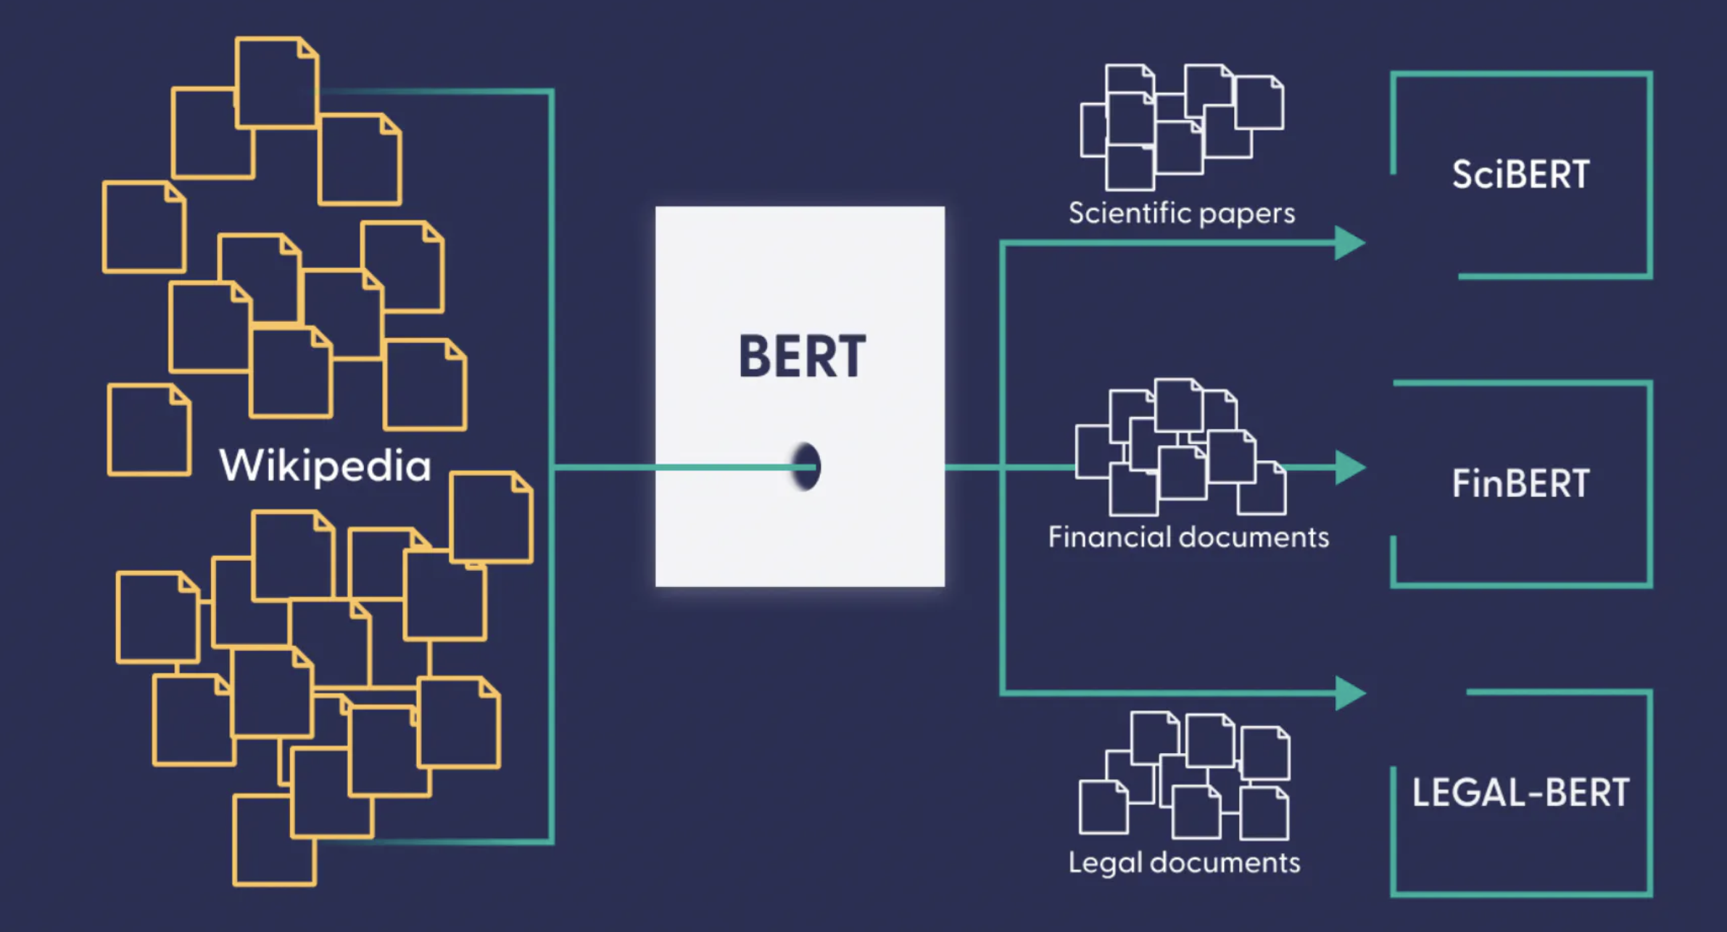
Natural Language Processing Domain Adaptation
Notes:
BERT

Slide 13
Demo – Small Language Model

Slide 14
Large Language Models (LLMs) How did they become so much more powerful?

Slide 15
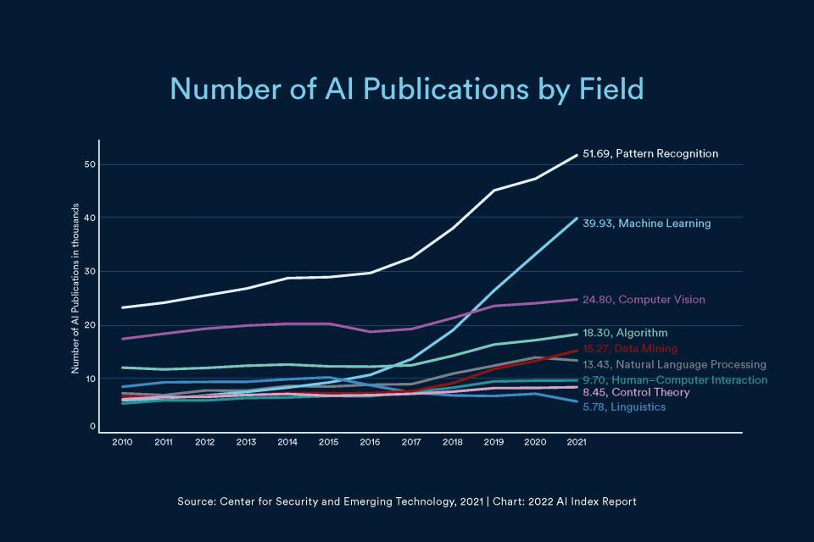
Research Effort

Slide 16
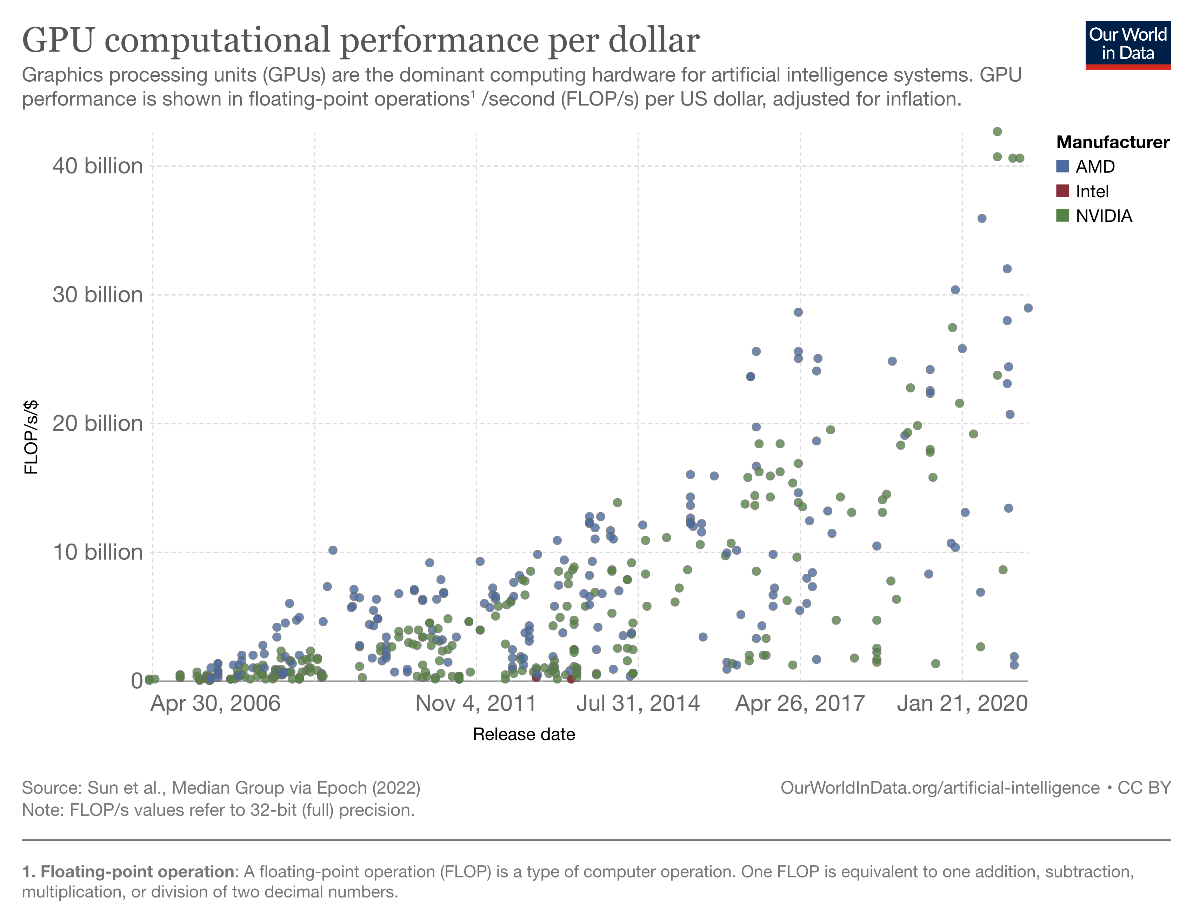
Hardware Improvement and Later Optimizations
FlashAttention
Quantization
Parameter-Efficient Fine Tuning
Low-Rank Adapdation
Notes:
Flash Attention is an efficient and precise Transformer model acceleration technique proposed in 2022. By perceiving memory read and write operations, FlashAttention achieves a running speed 2–4 times faster than the standard Attention implemented in PyTorch, requiring only 5%-20% of the memory. AFAIK it is an EXACT acceleration technique – there is no compression or approximation being done.
Quantization is a model compression technique that converts the weights and activations within an LLM from a high-precision data representation to a lower-precision data representation, i.e., from a data type that can hold more information to one that holds less.
Parameter-Efficient Fine-Tuning (PEFT) methods enable efficient adaptation of large pretrained models to various downstream applications by only fine-tuning a small number of (extra) model parameters instead of all the model's parameters. This significantly decreases the computational and storage costs.
LoRA (Low-Rank Adaptation of Large Language Models) is a popular and lightweight training technique that significantly reduces the number of trainable parameters. It works by inserting a smaller number of new weights into the model and only these are trained.

Slide 17
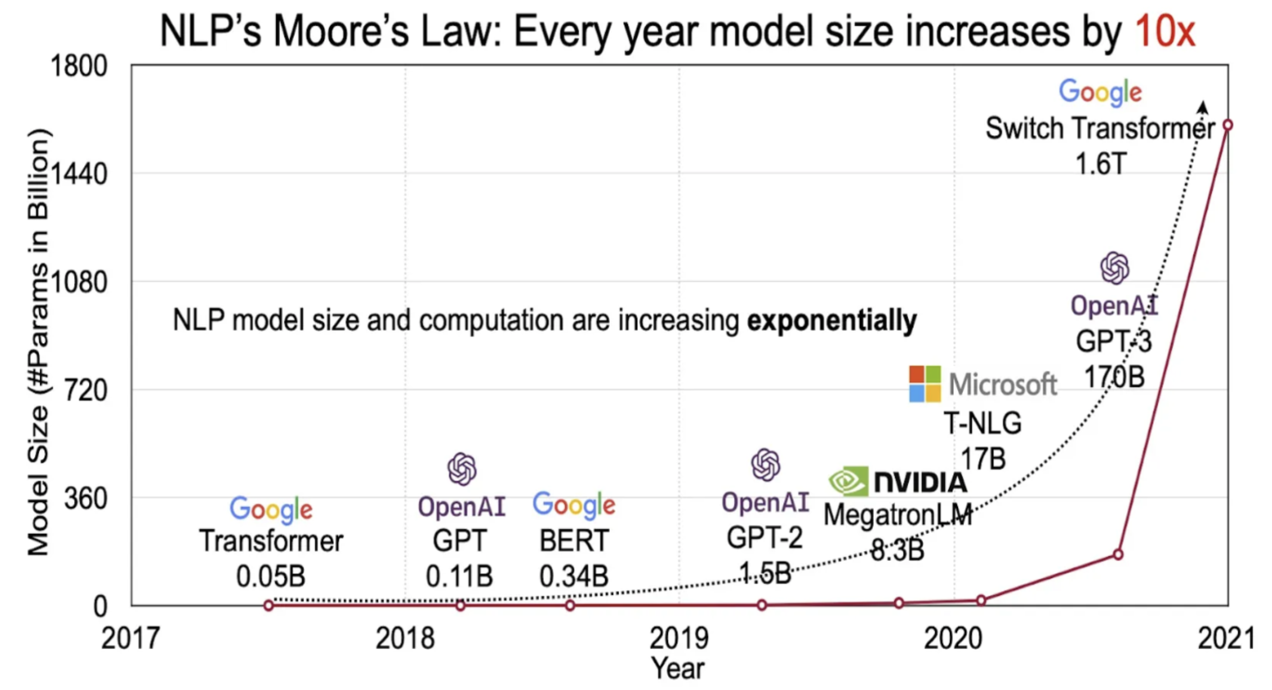
Scale

Slide 18
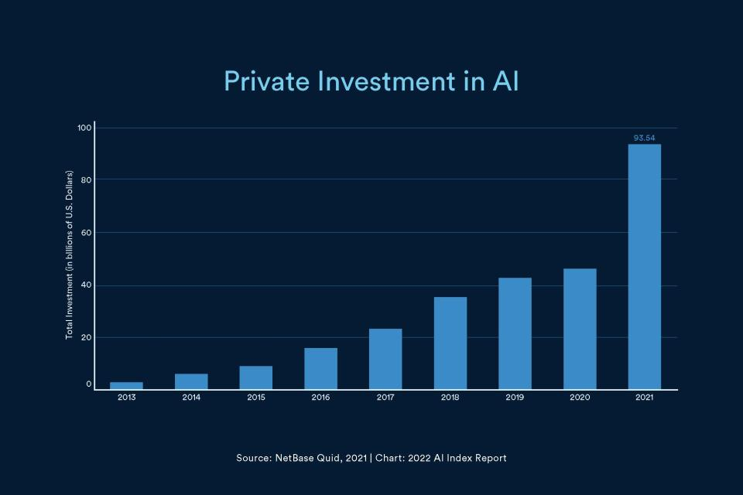
Investment

Slide 19
Large Language Models (LLMs) ChatGPT

Slide 20
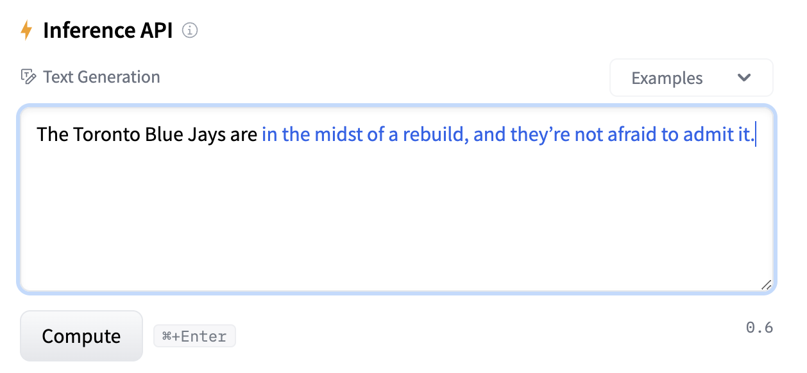
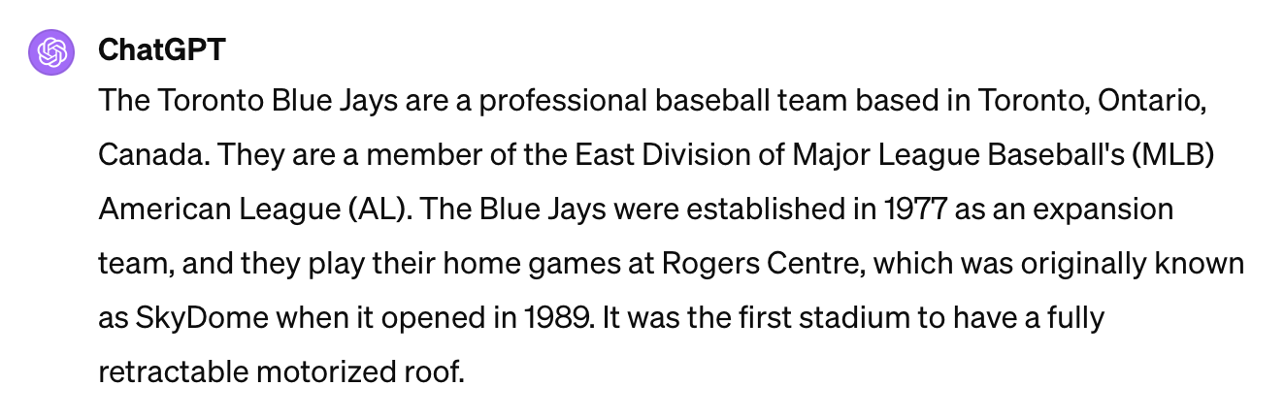
Inflection Point
GPT-NeoX 20B
ChatGPT

Slide 21
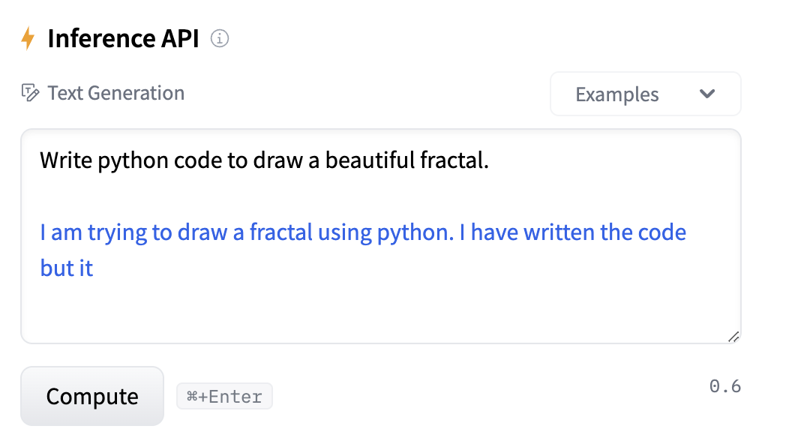
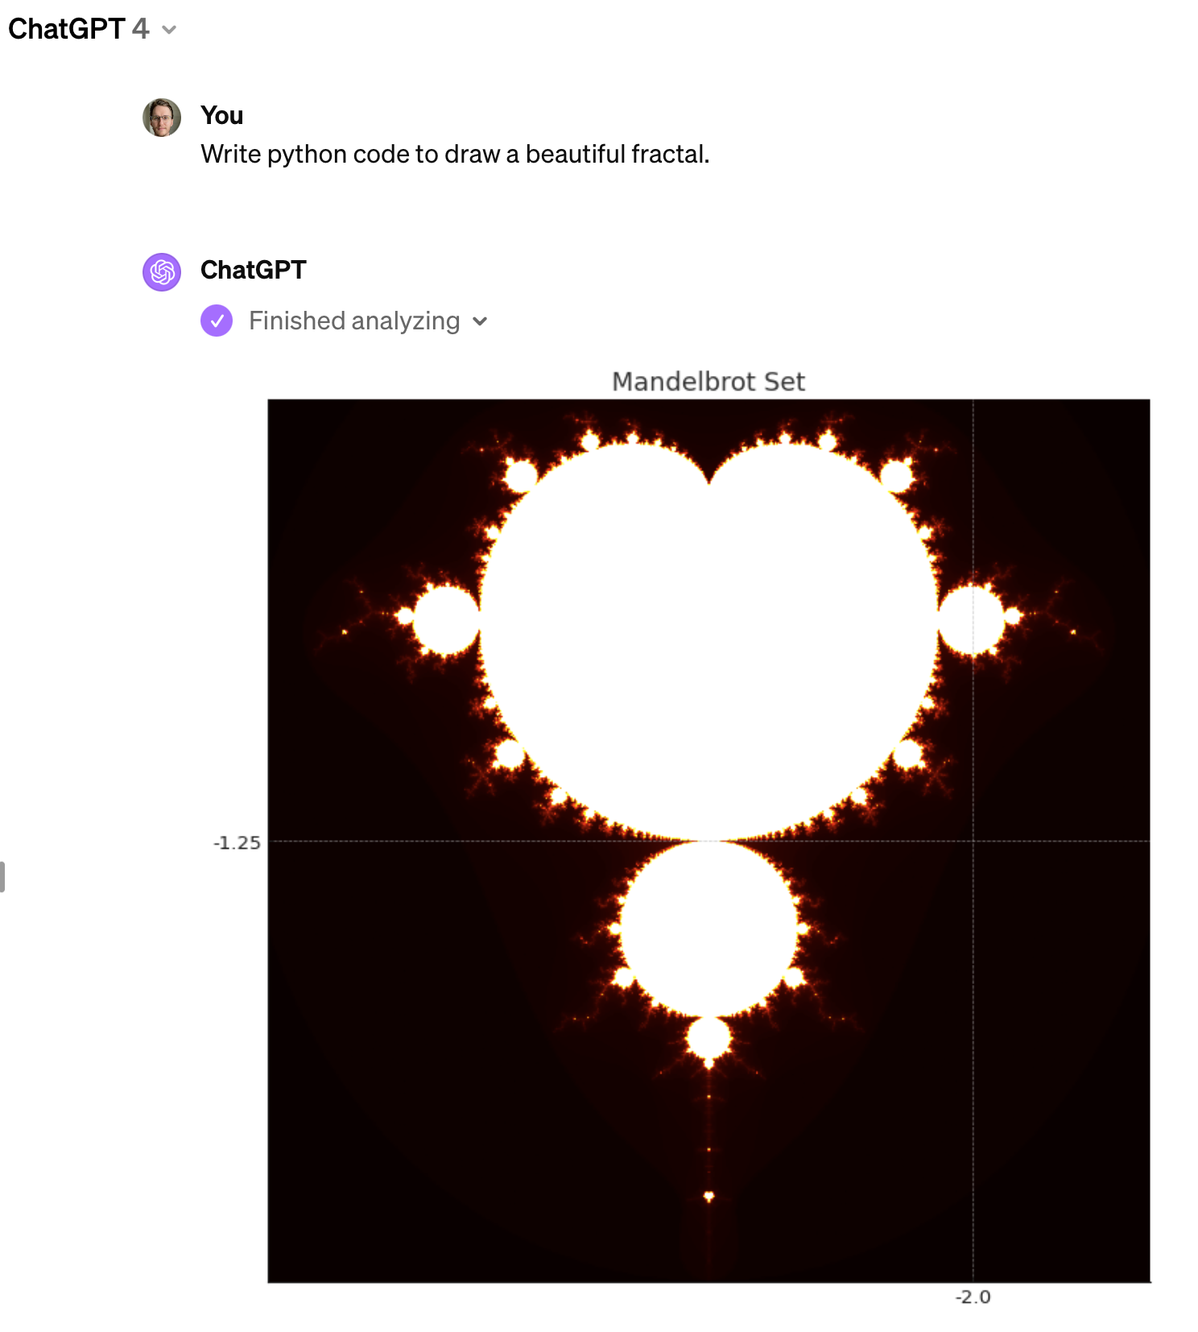
Inflection Point
GPT-NeoX 20B
ChatGPT

Slide 22
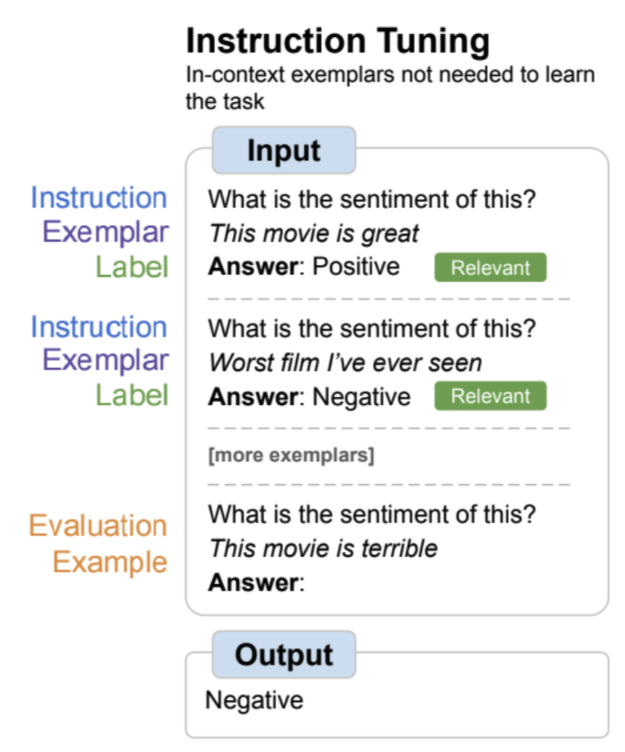
How, technically?
Decoder-only architecture
Massive scale
Training on code
Instruction Tuning
Reinforcement learning from human feedback

Slide 23
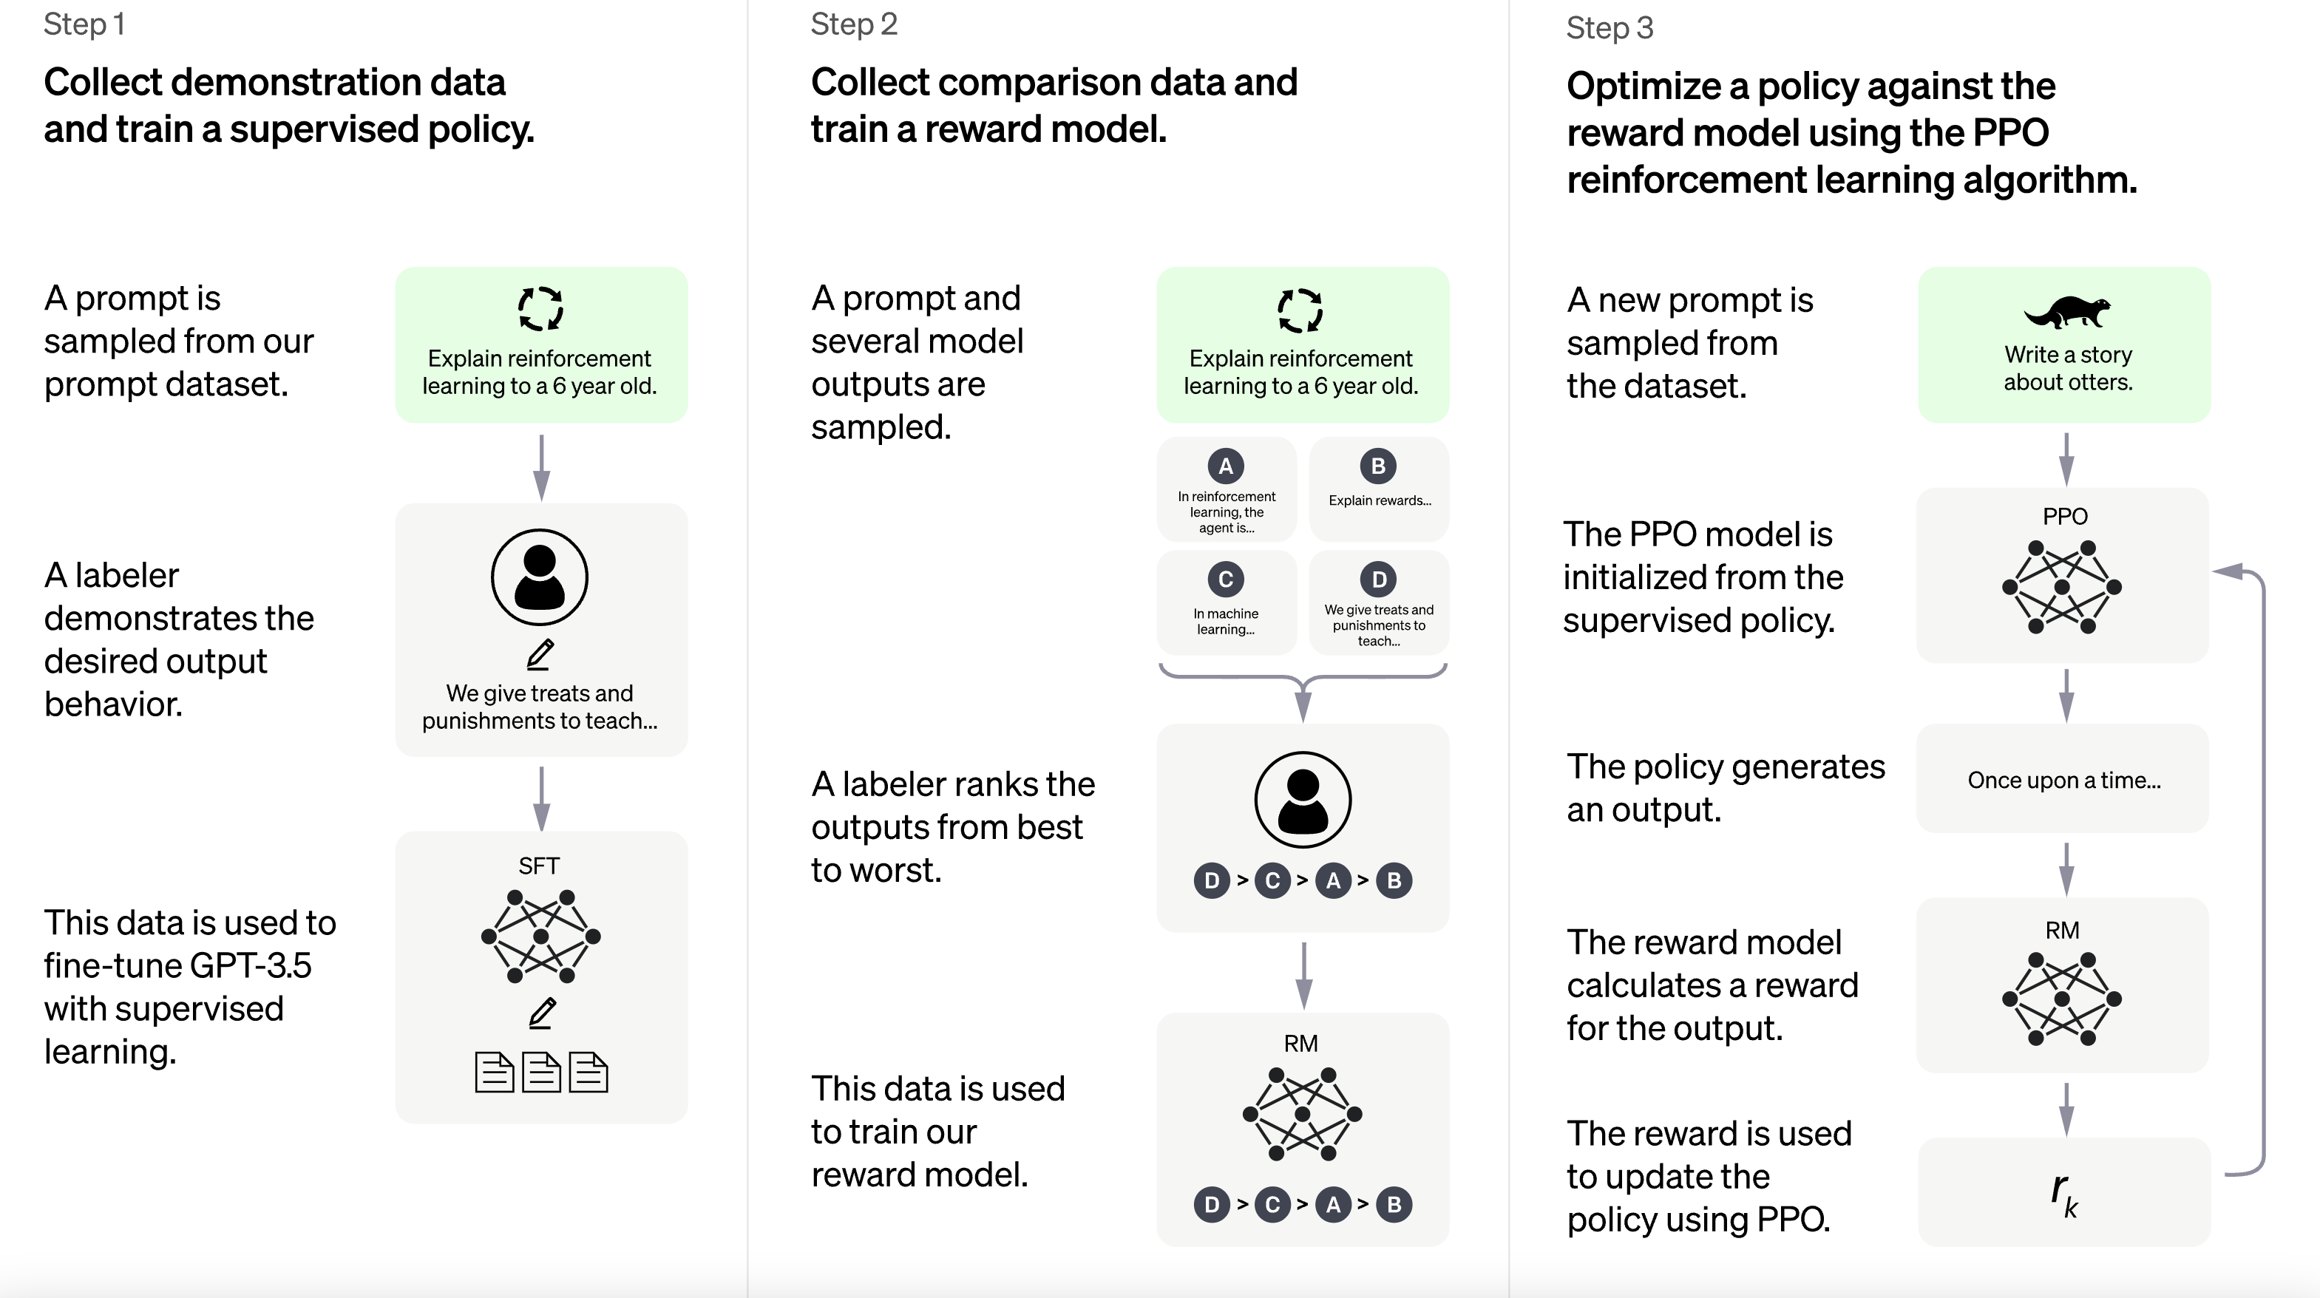
Reinforcement learning from human feedback (RLHF)

Slide 24
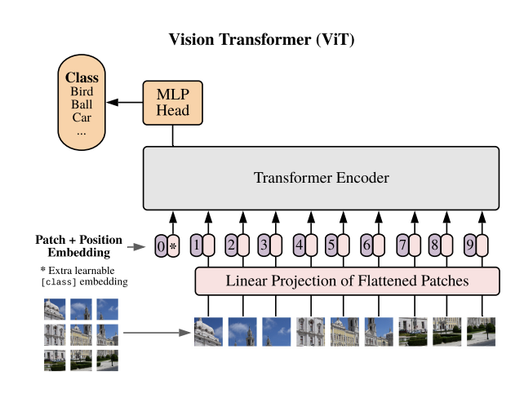
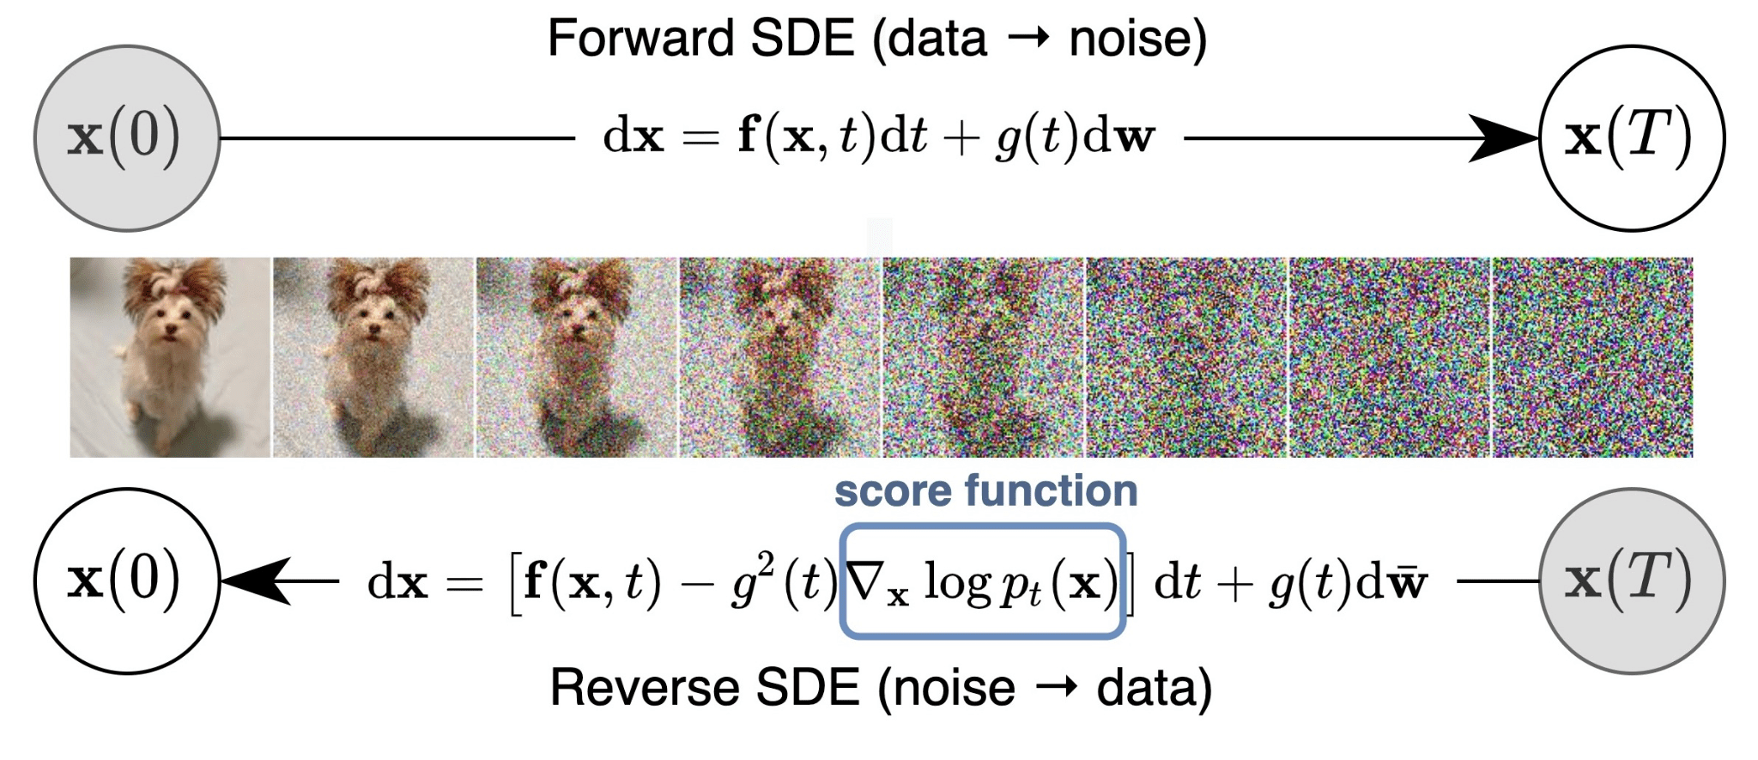
Multimodal Foundation Models
Vision Transformer
Generalized multimodality
Diffusion models

Slide 25
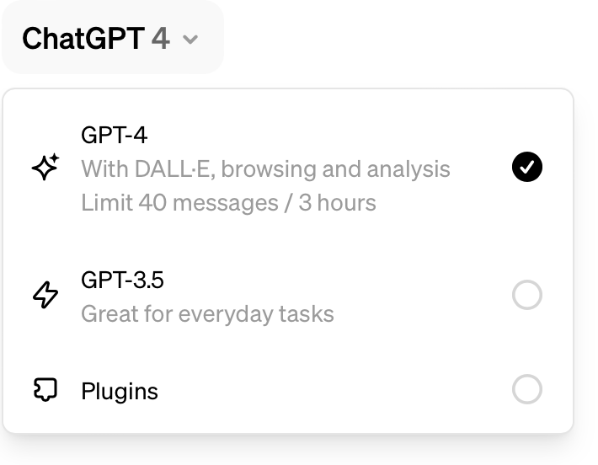
GPT-4
Provides an interface for multiple models, extensions.
The foundation model itself is multimodal: it was trained on text and images simultaneously.

Slide 26
Large Language Models (LLMs) The Competition

Slide 27
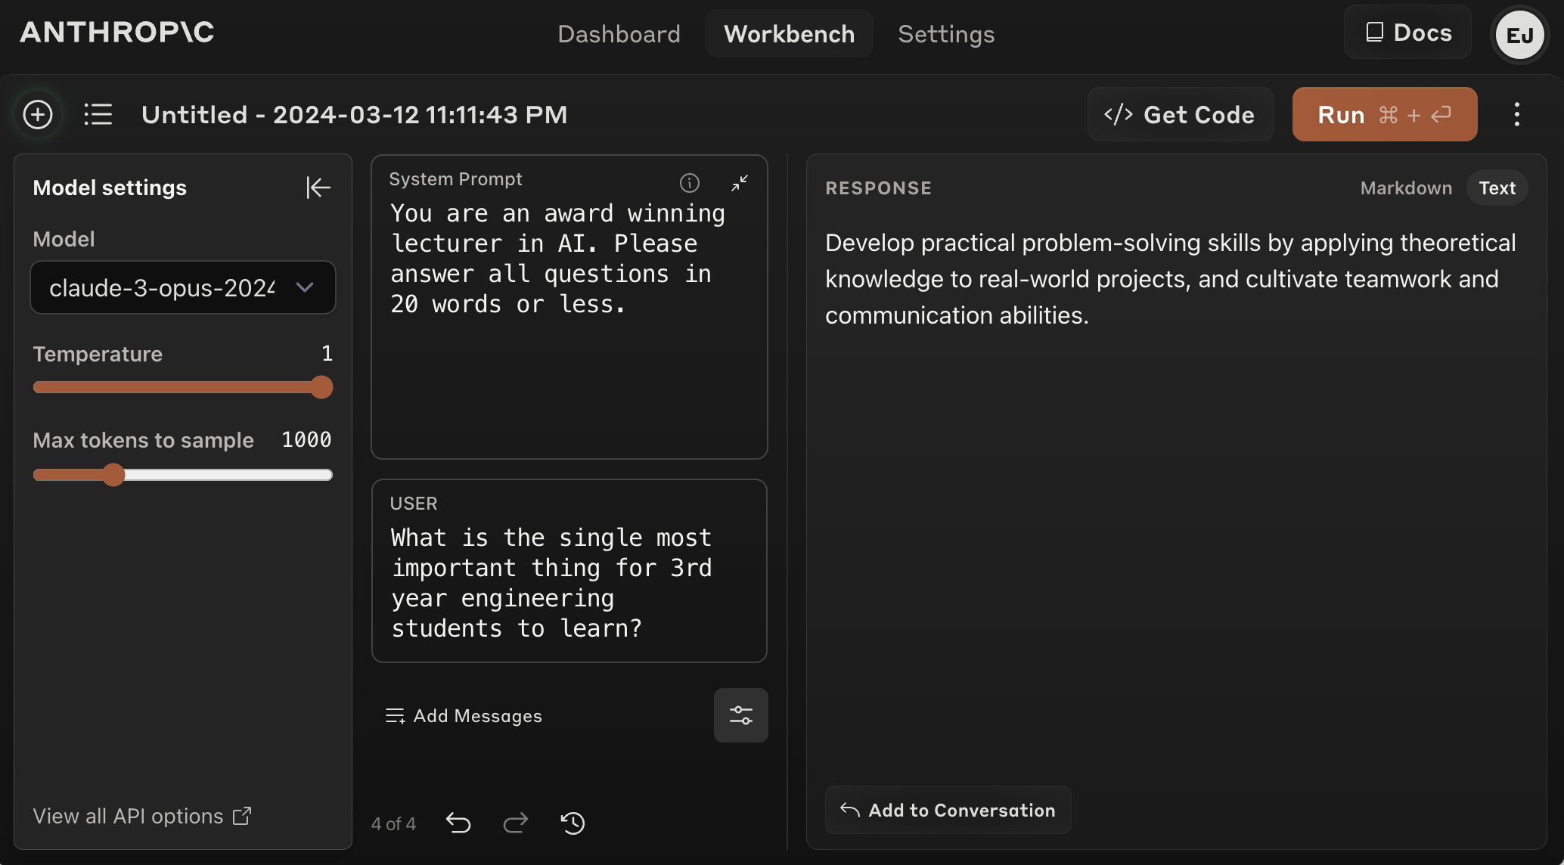
Commercial Competitors to OpenAI
Anthropic
Cohere
Google
Mistral
👍

Slide 28
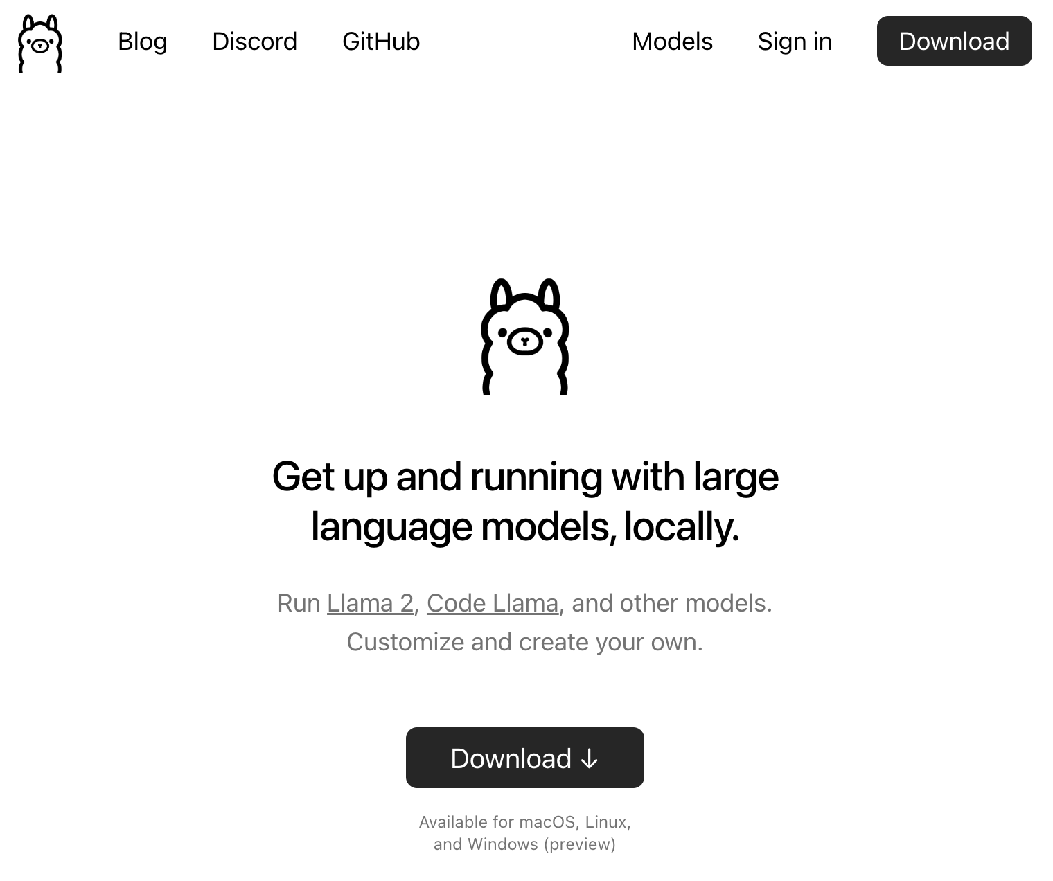
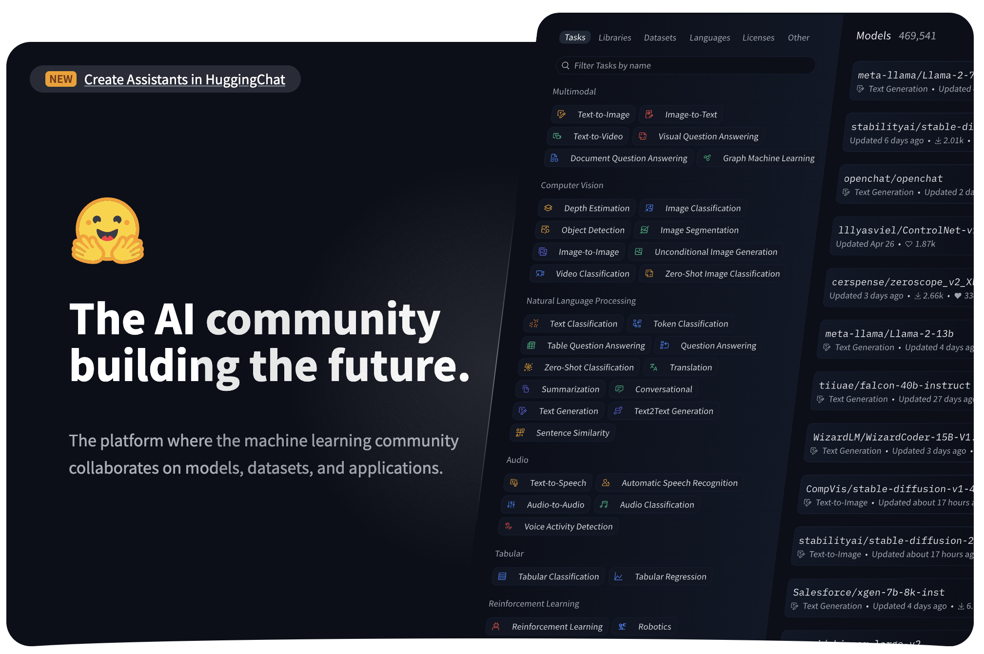
Open-Source* Competitors to OpenAI
Meta / Llama2
Google / Gemma
Microsoft / Phi2
Mistral / Mixtral

Slide 29
LLM Agents

Slide 30
LLM Agent Concepts and Abstractions
Zero Shot vs. Few Shot
Retrieval Augmented Generation
Chain of Thought
ReAct
Tree of Thought
LLM Evaluators
Many, many more.

Slide 31
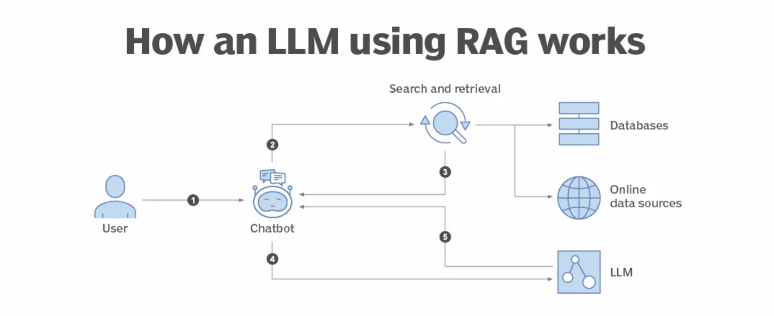
Retrieval Augmented Generation (RAG)

Slide 32
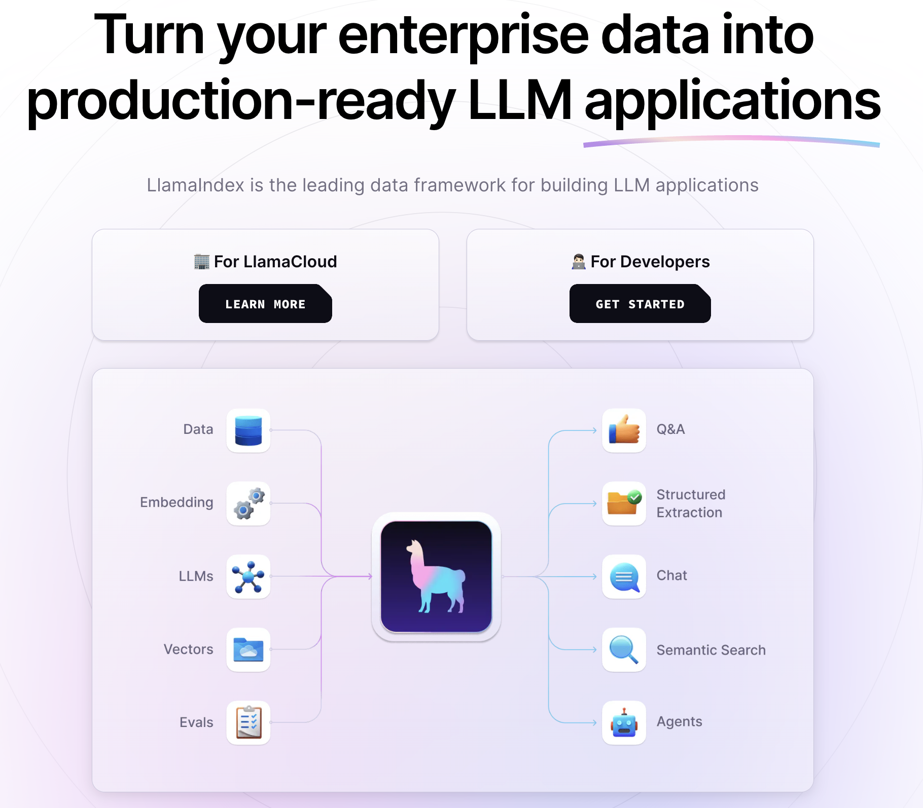
Framework Highlight: LlamaIndex

Slide 33
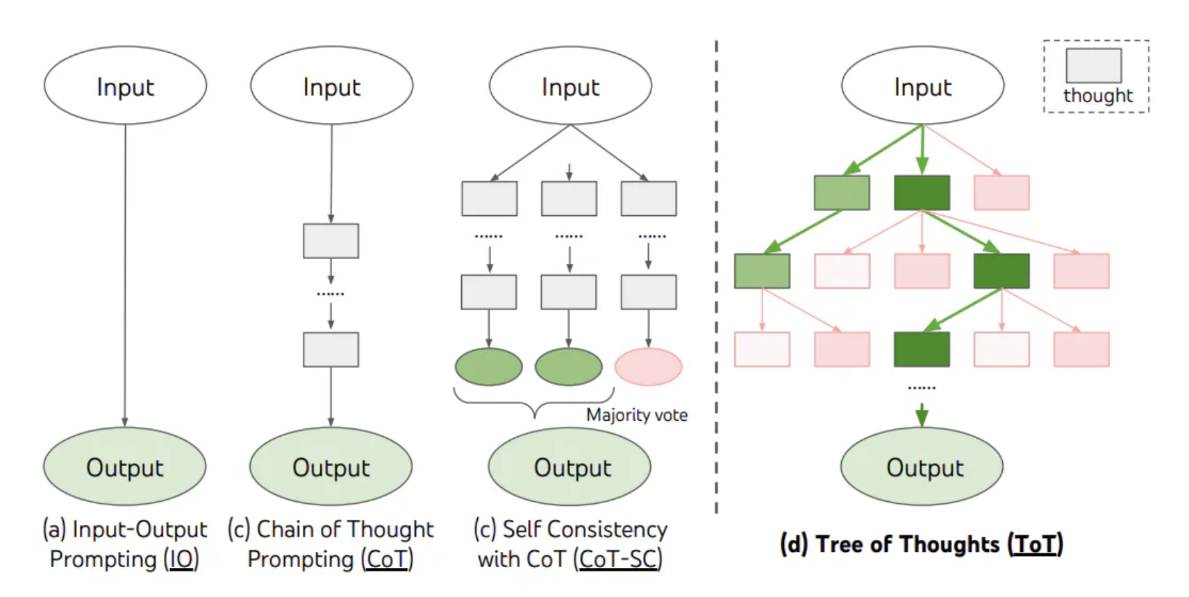
Chain of Thought, Tree of Thoughts Prompting

Slide 34
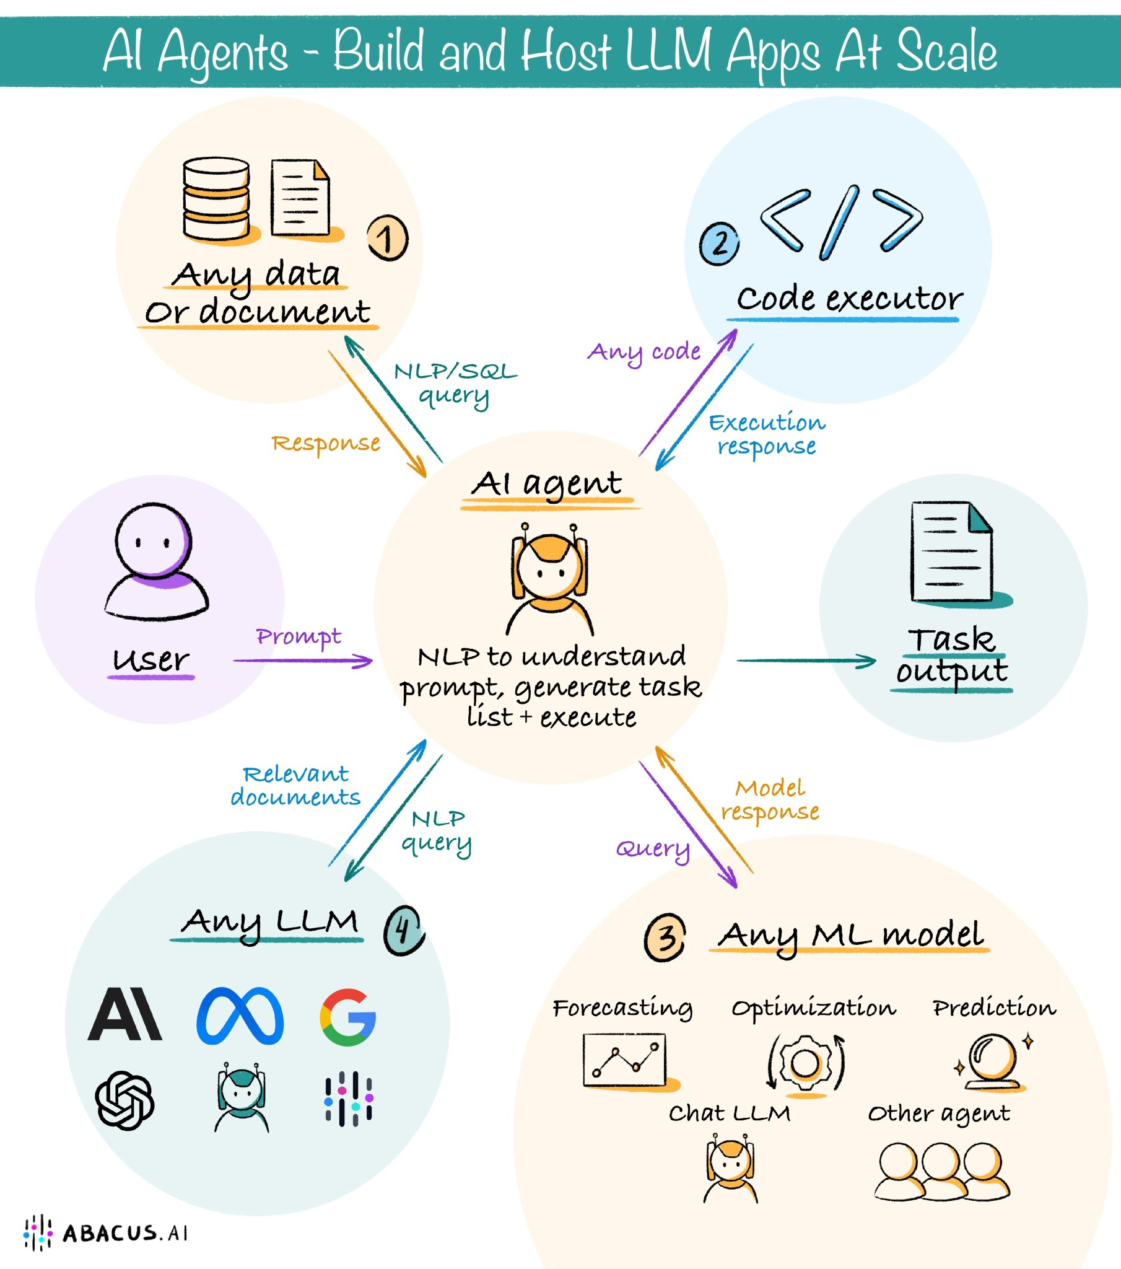
What Is An LLM Agent?
LLMs + Specialized Prompts + External Tools
Fine-Tuned Agents
Multiple Agents

Slide 35
Frameworks, Frameworks, Frameworks
GPTs
LangChain
AutoGPT
TaskWeaver
HuggingGPT
DSPy
Council

Slide 36
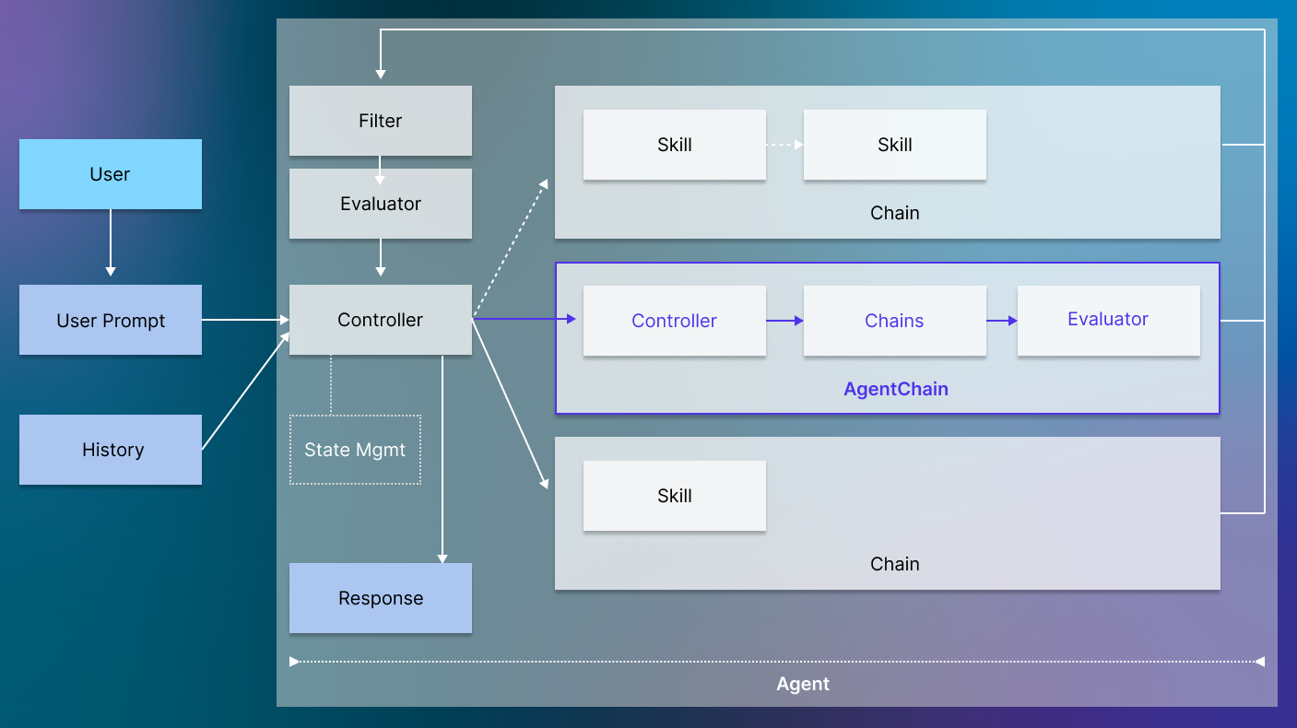
Framework Highlight: ChainML Council

Slide 37
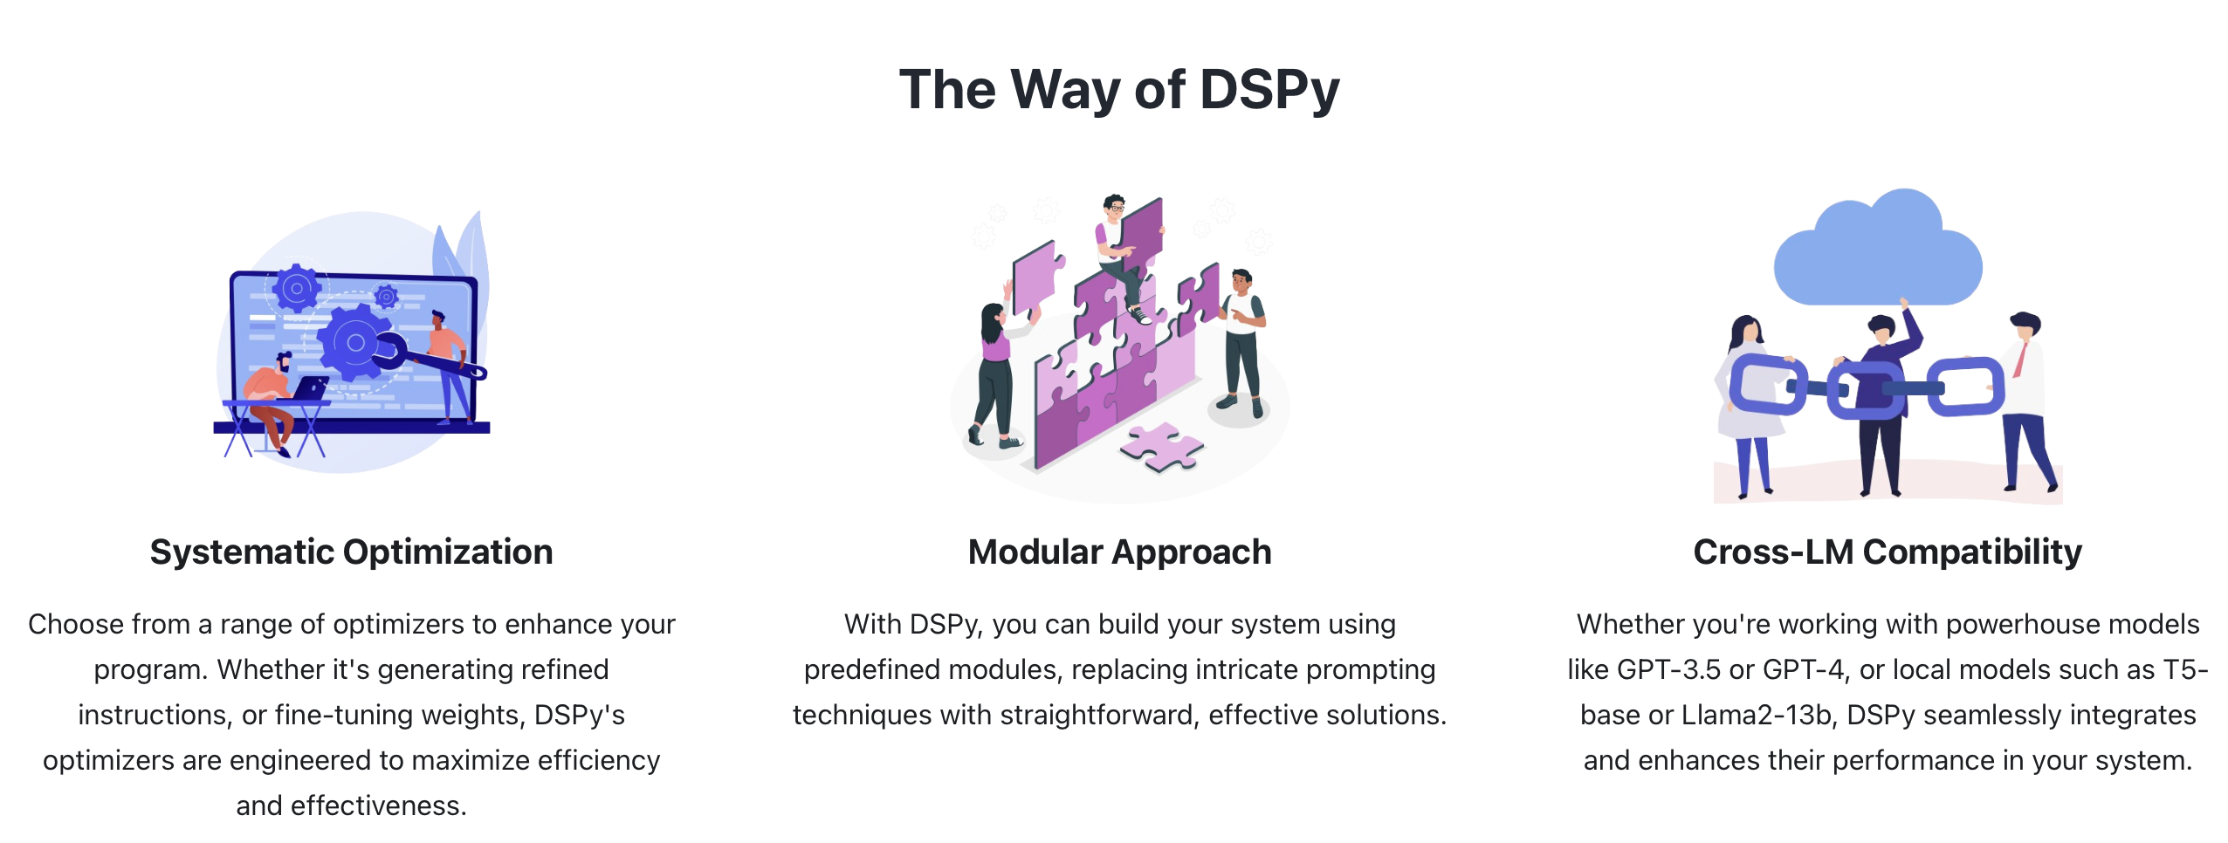
Framework Highlight: DSPy

Slide 38
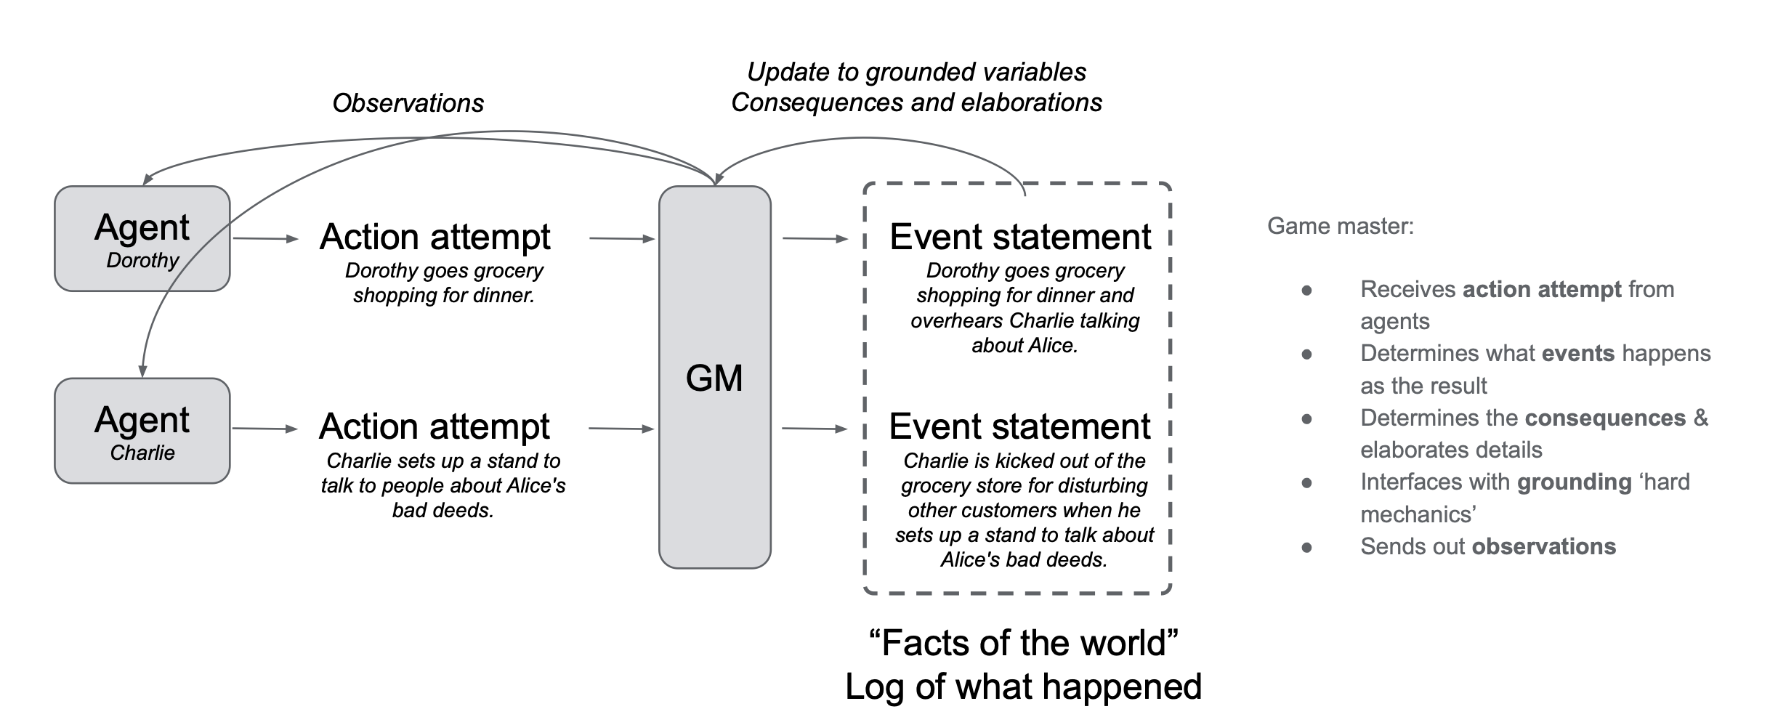
Multiagent AI
Generative Agents
Concordia
ChainML / Council

